Slide 1
Office DEVCamp – Los Angeles
Module 5: Hooking into Apps for Office
Registration for Los Angeles June 16 2015
http://aka.ms/O365campLA

Slide 2
Course Agenda
Office Camp
Module 1: Introduction to the Day
Module 2: Setting up the Environments
Module 3: Hooking into Apps for SharePoint
Module 4: Hooking into Office 365 APIs
Module 5: Hooking into Apps for Office
Module 6: Hooking into SharePoint APIs with Android

Slide 3
Hook into Apps for Office
Ivan Sanders
SharePoint MVP/MCT
ivan@dimension-si.com
@iasanders

Slide 4

Agenda
Overview
Apps for Word
Apps for Outlook

Slide 5
Overview

Slide 6
What is an App for Office?
A Web page loaded inside an Office Application
Embedded inline or as task pane within documents, mails or appointments.
Works in both Office Applications and Office Web Applications
Office application extensions using Web technologies
HTML 5 and CSS used to construct user interface
JavaScript and jQuery used to add executable logic and event handlers
App can provided code to read/write content to/from Office documents
App can call Web services hosted over Internet or running within local network
Notes:
An App for Office can be seen as a Web page loaded inside an Office Application. In some cases it will appear embedded inline within the document. In other cases it might appear as a task pane or within a message in Outlook. Note that the architecture for Apps for Office has been designed to work in both Office Applications and Office Web Applications.
WEF and Apps for Office allow Office applications to be extended in such as way so that they can leverage Web technologies such as HTML 5 and CSS for rendering user interface as well as JavaScript and jQuery to add behavior. When you write the JavaScript code for an App for Office, you can call REST APIs such as those added to SharePoint 2013 to retrieve and update data from across network.

Slide 7
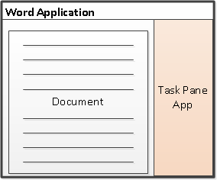
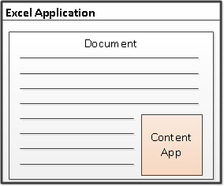
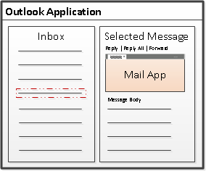
Designing Apps for Office - Shapes
Apps for Office come in three different shapes
Task Pane App (only shape supported by Microsoft Word)
Content App
Mail App
Notes:
When you begin to design an app, you must pick one of the three different shapes. You can create a document-based app as either a Task Pane App or a Content App. Alternatively, you can create a Mail App that targets Outlook and Outlook OWA.

Slide 8
App for Office Runtime Environment
Web Extensibility Framework (WEF)
Allows Web page content to render inside Office Application
Allows Web page code to run within a set of constraints
Allows Web page code to interact with Office documents
Allows Web page code to interact with Exchange items
WEF provides runtime environment for Apps for Office
Apps for Office provide basis for a component architecture
Apps for Office provide ability to publish to App Catalogs and/or Office Store
Apps for Office can be deployed in private networks
Notes:
The Web Extensibility Framework (WEF) is a new development platform used to extend Office applications. This platform allows Web page content to render inside Office Application and to interact with Office documents such as Word document and Excel workbooks and Exchange items such as messages and appointments.
The WEF development platform is used to develop Apps for Office. Apps for Office provide basis for a component architecture which allows developers to build apps which target Office application and Office Web applications such as Excel services and Outlook Web Access.
WEF and the Apps for Office development model provide foundation for distribution of apps using an app directory such as the Office Store and the App Corporate Catalog used to deploy apps in private networks.
Throughout the beta cycle of Office 2013, Apps for Office have been given a codename of "Agave". Note that this codename is only intended for the beta cycle and will disappear by RTM when they will just be called "Apps for Office" or a variation thereof.

Slide 9




Anatomy of an App for Office
Each App for Office is based on XML-based manifest
Manifest points to a Web page
Manifest defines the type of the App for Office
Manifest defines which Office applications it supports
Manifest defines required capabilities
App for Office
Catalog Server
Web Server
App for Office
App for Office
Manifest
<XML>
Web
Page
HTML+JS
Notes:
Every App for Office must be distributed with an XML-based manifest which contains information about the app itself. For example, the app manifest contains an address to a Web page on the Internet which is used to load the app. The app manifest also includes information which indicates which Office applications it supports. The app manifest also defines the required capabilities which represent the set of permissions that the app needs in order to run and complete its work.

Slide 10
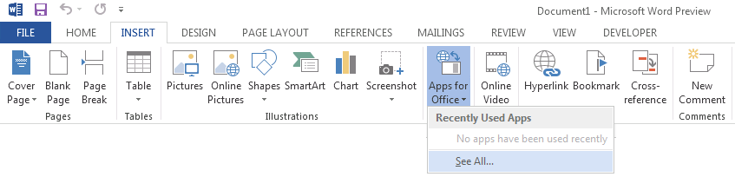
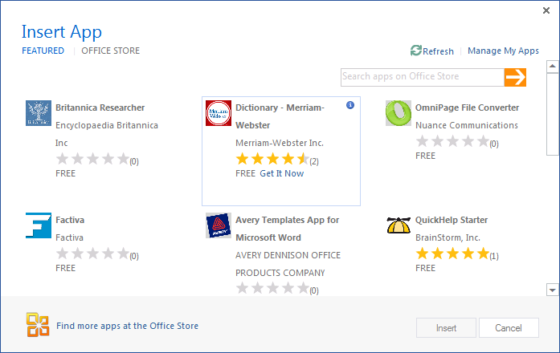
Adding a App for Office using the Insertion UI
Apps for Office insertion UI located in Ribbon inside Insert Tab
Dialog allows you to add and start App for Office app
Notes:
Office 2013 applications provide users with the ability to discover apps and insert them. In Word and Excel, this support is included in the Ribbon inside the Insert Tab. As you can see from the slide above, the drop-down menu for inserting apps has a caption of "Agaves" in the beta cycle and will be updated to say "Apps" before RTM.
When you drop down the Apps menu from the ribbon, you can see recently selected apps. If you click "Select All", you will be prompted with a dialog that allows you to look in various app directories. Once you find an app you want to use, you can click the Start button to insert the app into the current document and start it up. After this, you can save the current document which will then include the app.

Slide 11
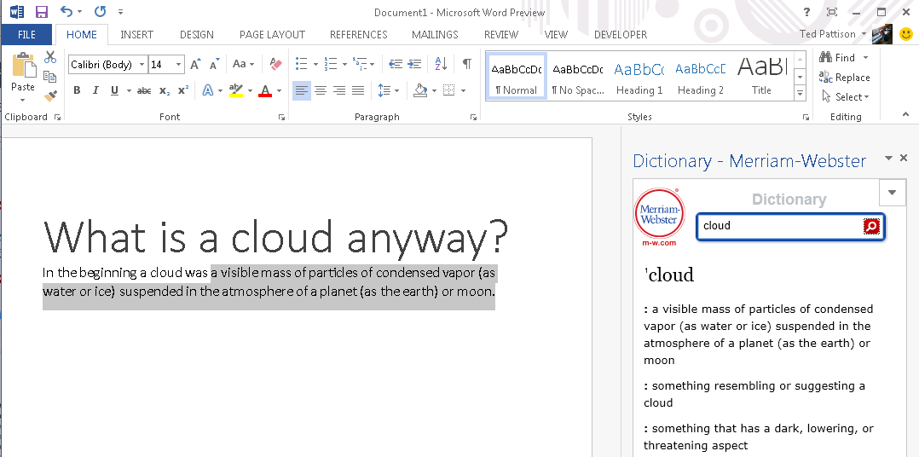
Task Pane App User Experience
Familiar User Experience
Leverages familiar Office UI paradigm
Reference Information
Ideal for providing reference information associated with document.
Notes:
One reason to create a task pane app is that it provides Office users with a familiar user experience. For example Microsoft Word and Microsoft Excel have exposed many of its internal features using task panes so task pane apps provides a familiar Office UI paradigm.
Task pane apps are ideal for providing users with reference information. For example, a task pane app can perform Internet searches or lockups and provide reference information that can be inserted back into the current document.
This slide contains a screenshot showing the app after it has been inserted in a document. In Microsoft Word 2013. Different apps provide different user experiences. This app which is available for free on the Office Store allows the user to leverage the Marriam-Webster online dictionary lookup service to look up words and terms right from within Microsoft Word.

Slide 12
Apps for Word

Slide 13
Visual Studio Experience
Create new App for Office project
Create/design user interface for Web page
Enhance Web page with CSS and JavaScript
Set project properties in manifest
Run!
Notes:
This slide is pretty self-explanatory and demonstrates just how easy it is to create and test your first App for Office using Visual Studio 2013. First, you will create a new project using one of the new project templates in Visual Studio 2013. Next, you will create the user interface for the app using HTML5 and CSS. After that, you add behavior to the app by writing JavaScript. Finally, you will update the XML file which serves as the app manifest. After that, you can press the {F5} key to test and debug your app.

Slide 14
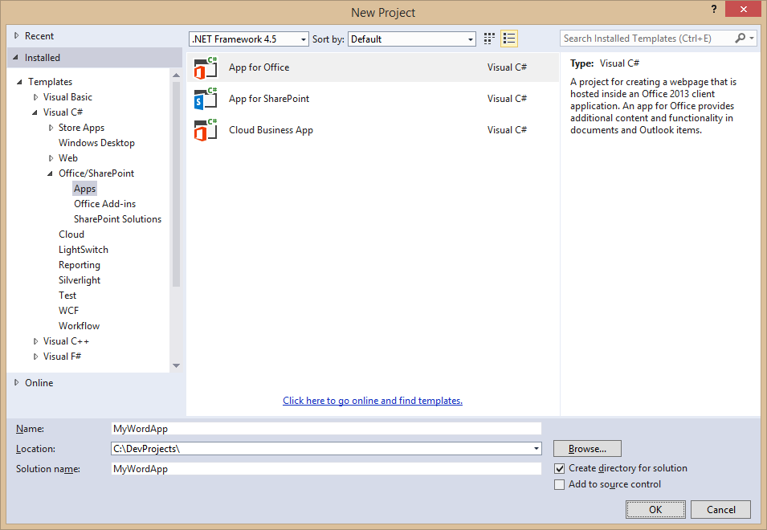
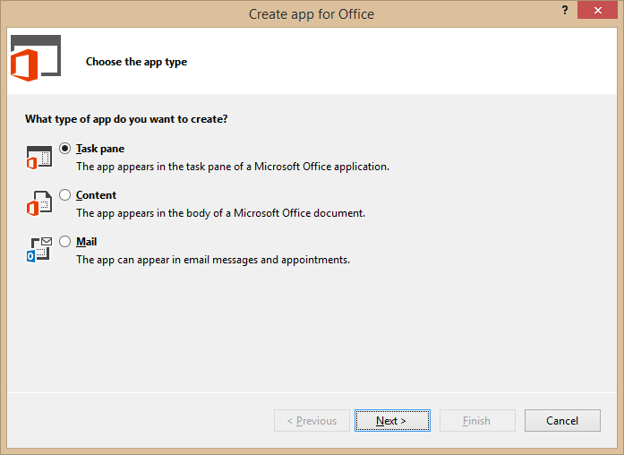
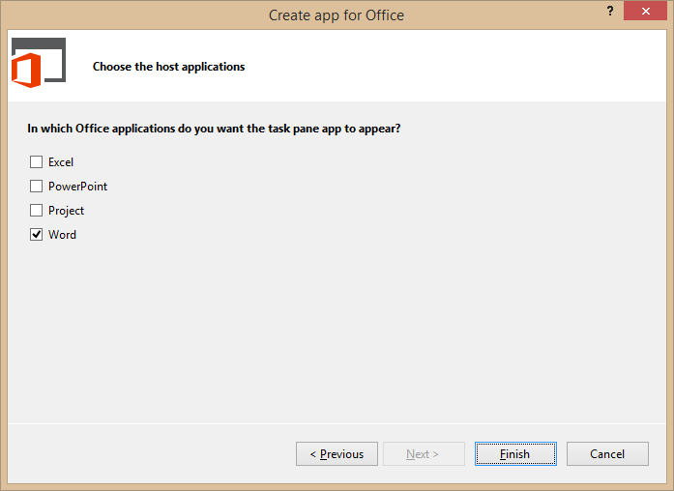
Create New App for Office Project
Create project based on App for Office 2013 project template
Dialogs appear and prompts you for specifics about the app
You must choose (1) the app share and (2) which Office application are to be supported
Notes:
Visual Studio has a new project template for Apps for Office. These project types gives you a starter project with a web page and manifest.

Slide 15
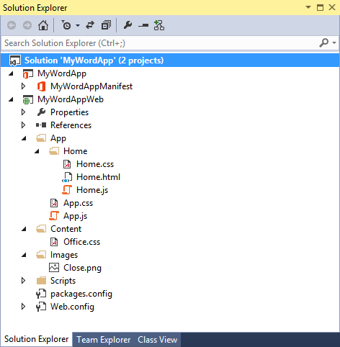
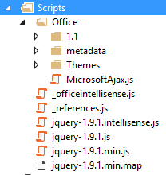
App for Office Project Structure
App for Office solution has two projects
Top project contains app manifest
Bottom project for remote web
Remote Web Project is ASP.NET Website
Contains HTML, CSS and JavaScript source files
Integration with jQuery library already included
Notes:
The slide shows the initial structure of a task pane app created with the Visual Studio 2013.

Slide 16
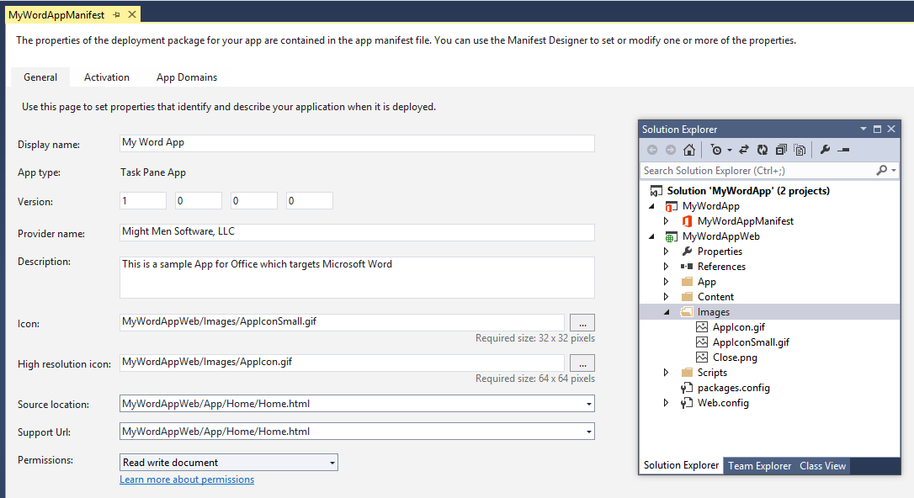
App Manifest Designer
Notes:
This slide shows the Visual Studio designer for an app manifest in a task pane app. It will look different for other types of Apps for Office.

Slide 17
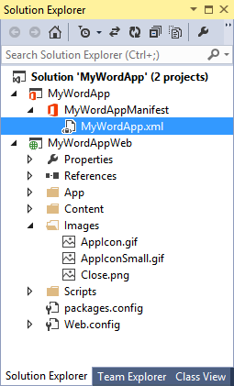
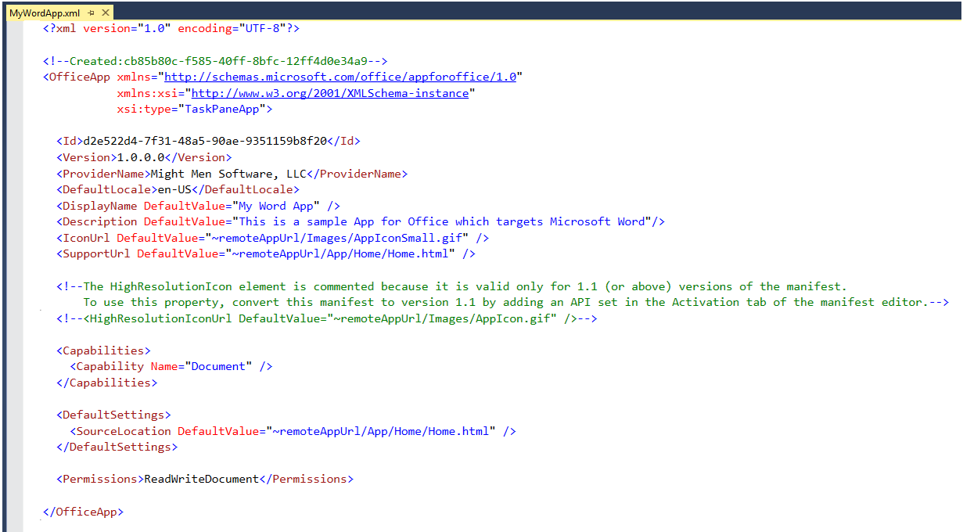
App Manifest - XML View
Notes:
There are times when it is also useful or necessary to examine or update the manifest in XML view. You can enter XML view by clicking the XML file in the Solution Explorer.

Slide 18
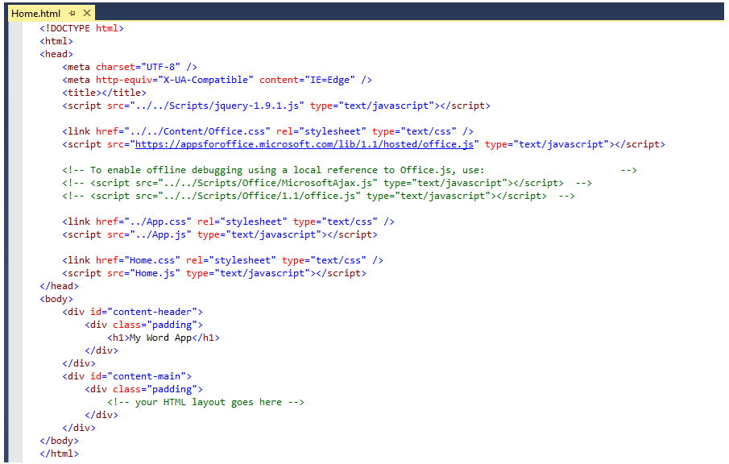
Create the HTML for a Web Page
Notes:
Each app has a source location which points to a entry point Web page somewhere on the Internet. Here is an example of a simple Web page that is used to load a task pane app. Note that this page must link to any required CSS files and JavaScript that will be adding styles or behavior behind the app. Visual Studio automatically adds the links for jQuery and ASP.NET AJAX. Also note that the page adds HTML elements which are often created with ids and/or classes.

Slide 19
Navigation and Links
DOs
Provide hyperlinks to open in browser
Design app to fit on one host page
Use iFrame with navigation bar if absolutely necessary
Consider ways to provide messages to users
DON’Ts
Expect hyperlinks to open in app window (blocked).
Send users to trapped pages via poor navigation trails
Use alerts
Notes:
This slides discusses what to use and what to avoid when designing an app.
Do provide hyperlinks within an to open Web pages in a new browser window. This makes it easier to design an app that fits cleanly on a single host page. Within the host page you can also use an iFrame to host content and provide a navigation bar if needed to change the contents of the iFrane using JavaScript. Also consider how your app will provide informational messages to the user. Typically this is done by adding a HTML element such as a div to the host page and dynamically writing text inside using JavaScript.
Here is a list of design issues to avoid. When creating hyperlinks, do not use <a> tags without a target attribute to open the link in a new window browser. You will find that such links are blocked by the Office UI if they attempt to take the user to a different domain. Also avoid links which navigate the user to pages which do not allow them to return to the start page as there is nothing similar to the back button inside the browser. Also, avoid interaction with the user using the poor man's technique of using the JavaScript alert function which has more restrictions inside an app than it does when used inside a browser.

Slide 20
Context Menus and Settings Controls
Full control of what is inside the App for Office
Developer can override the right-click Context Menu
No Control to customize the App container menus.
Developer cannot customize Task Pane or Content/Chart object menu
Ability to save settings to “property bag”
Property bag values saved with the app in the document
With Mail Apps for Office property bag values save within Exchange
Notes:
If you want an app to provide custom menus to the user, you should understand that you have control only of the users interface inside the app but not any UI elements outside. You can override the app context menu that appears at the upper right-hand corner of an app. However, when creating an app you have no control over customizing any other menus within Office apps.
Also remember that you have the ability to save custom properties as name values pairs using the settings API. These names value pairs are saved within the current document with task pane apps and with content apps. With mail apps these property values are saved within Exchange along with the host message or appointment.

Slide 21
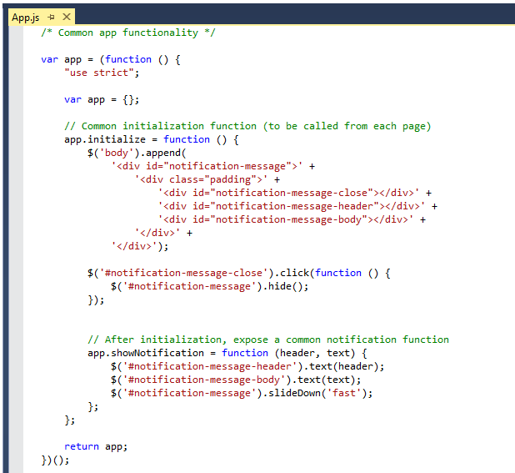
Code Added by Visual Studio
Notes:
JavaScript is the language that is used to add executable code and behavior to a App for Office. The JavaScript you write for an app will typically take advantage of the various JavaScript APIs supplied for Office.js and other JavaScript library files for specific Office applications such as Word, Excel and Outlook. In addition to the Office JavaScript APIs, the JavaScript code you write for an app for Office can also take advantage of the ASP.NET AJAX library as well as jQuery.
The Office JavaScript API provide a top-level named Office which provides an initialize function. By overriding this function as shown in the code above, you can write code that will automatically execute as the end of the initialization process when an app is started. A common approach is to register a jQuery document ready event handler inside this function.

Slide 22
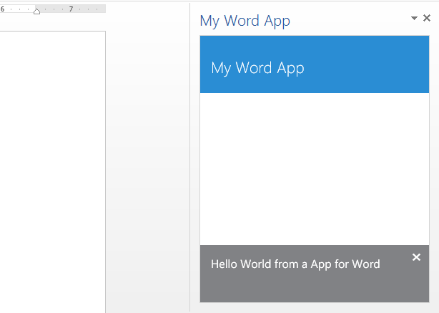
Test/Debug the Apps for Office using {F5}
When you press the {F5} key…
Visual Studio builds the app package and temporarily registers it
Visual Studio starts Microsoft Word and adds the app to new Word document
Notes:
When you press the {F5} with a Visual Studio 2013 project for an task pane app or a content app, Visual Studio automatically adds a registry entry to allow Office applications such as Word and Excel to discover the app which makes it possible to add it to a document.

Slide 23
demo
Task Pane App in Word

Slide 24
Apps for Outlook

Slide 25
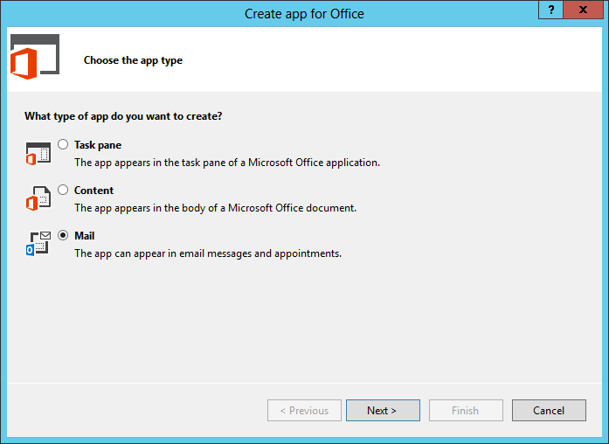
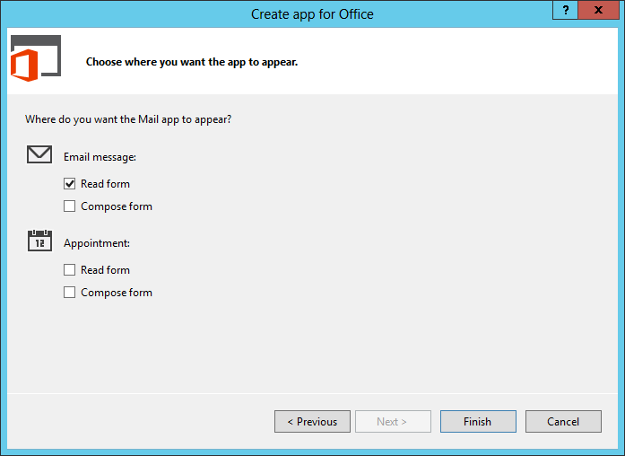
Create New App for Office Project
Notes:
Visual Studio has a new project template for Apps for Office. These project types gives you a starter project with a web page and manifest.

Slide 26
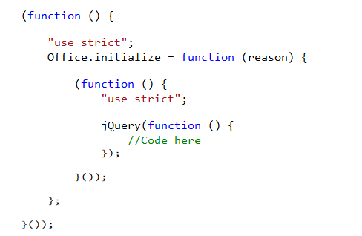
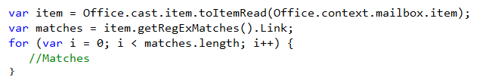
Coding
Reference office.js
Initialize
Code

Slide 27
Debugging
Provide account information
Log into Outlook
Apps appear in context
Launch app from bar

Slide 28
demo
ApP in Outlook

Slide 29
Summary
Overview
Apps for Word
Apps for Outlook

Slide 30

© 2012 Microsoft Corporation. All rights reserved. Microsoft, Windows, and other product names are or may be registered trademarks and/or trademarks in the U.S. and/or other countries.
The information herein is for informational purposes only and represents the current view of Microsoft Corporation as of the date of this presentation. Because Microsoft must respond to changing market conditions, it should not be interpreted to be a commitment on the part of Microsoft, and Microsoft cannot guarantee the accuracy of any information provided after the date of this presentation. MICROSOFT MAKES NO WARRANTIES, EXPRESS, IMPLIED OR STATUTORY, AS TO THE INFORMATION IN THIS PRESENTATION.

